Slide 1
Command-Line Interface

Slide 2
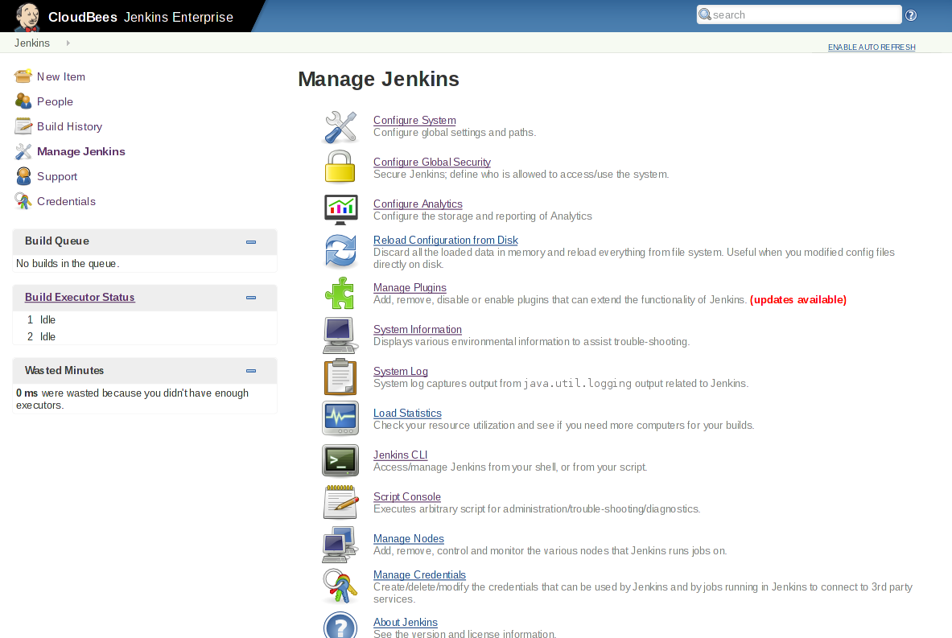
Using CLI
Entrance to CLI (or /cli)

Slide 3
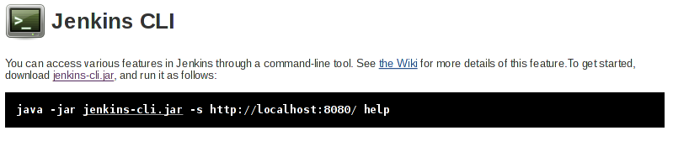
Using CLI
“-s” sets Jenkins to connect to
“JENKINS_URL” environment variable replaces it if needed

Slide 4
How it works
CLI makes an HTTP call to Jenkins, discovers the port
CLI attempts to open TCP/IP connection
If it fails, fall back to HTTP-based connection
Slow and wastes effort, but works with reverse proxy
Command execution mostly happens on master
But sometimes code gets downloaded
Therefore, one CLI jar can be used to talk to different masters
CLI JVM
Jenkins

Slide 5



CLI Authentication
By SSH public key
Register your public key to Jenkins under your user account
Hide your private key in ~/.ssh
Jenkins JVM
CLI JVM
User | Public Key
Kohsuke
Ryan
Stephen

Slide 6
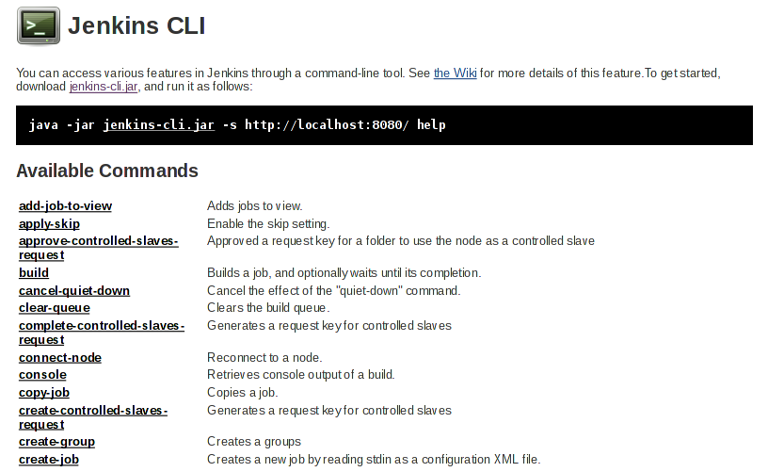
Existing CLI commands
Plugins can contribute commands, this list can grow

Slide 7
CLI Show Case: build command
Equivalent of clicking “build now”
Can take parameters:
-c:run polling first and build only if there’s a change
-s: don’t just schedule, but wait until the build is completed
-p: specify build parameters
-v: report console output as well

Slide 8
CLI Show Case: CRUD of jobs
create-job, get-job, update-job, delete-job
Reads/writes XML representation of the job
use stdin/stdout of CLI process
Can be used to script job creation / update

Slide 9
CLI Show Case: groovysh
Interactive Groovy shell to manipulate the in-memory state of Jenkins
Equivalent to the script console, but interactive
% java -jar jenkins-cli.jar -s http://localhost:8080/ groovysh
Groovy Shell (1.6.0, JVM: 1.6.0_26)
Type 'help' or '\h' for help.
-----------------------------------------------------------------
groovy:000> import jenkins.model.Jenkins
===> [import hudson.model.*, import jenkins.model.Jenkins]
groovy:000> Jenkins.instance.description
===> My description

Slide 10
More on Groovy in CLI
Use “groovy” command to run a pre-authored script file
See https://github.com/jenkinsci/jenkins-scripts for scripts other people wrote

Slide 11
Write Your Own Scripts
Useful references
http://javadoc.jenkins-ci.org
For a better assisted environment:
Set up a plugin development environment
Your IDE can now provide debugger, content assist, javadoc lookup, etc.

